Slide 1





Slide 2

Crop-Core Tech - a platform offering 360-degree Agri based solutions.
Monitors real-time weather, nutrient levels, market prices etc.
Smart features include irrigation regulation, monitoring, yield prediction, weed detection, and disease scouting.
Simple, effective and user-friendly interfaces.
Offers a collaborative community, government schemes, insurance information, and personalized crop recommendations.
USPs
360-degree Agri solution
Collaborative Farming Community
Integrated Government Schemes and Insurance Tools
Real-time Market Price Tracker
Electricity Consumption and Insurance Calculator

Slide 3




Key Features:
Collaborative Farming Network for Knowledge Sharing and Resource Pooling: A farming community where farmers can connect, share insights, and pool resources for optimized agricultural practices.
Government Support: Farmers have access to government schemes, insurance plans, a crop insurance calculator, and financial protection.
Real-Time Monitoring: Leverage sensors for real-time nutrient management, weather updates, and automated crop scouting to detect diseases and provide timely reports.
Smart Farming Solutions: Optimize irrigation with water conservation techniques, and track electricity consumption based on motor runtime using an electricity calculator.
1/2

Slide 4




Key Features:
AI-Powered Insights: Personalized AI-driven crop advisor offering tailored crop recommendations, growth guidance, and insights into weed detection and yield prediction. Includes a fruit ripeness detector to ensure optimal harvest times.
Market and News Updates: Stay updated with real-time market price tracking, trending agricultural news, and access to essential conditions for optimal crop growth.
Virtual Marketplace and Mobile Payment Integration: A virtual marketplace for trading agricultural products, along with mobile payment integration to streamline transactions.
Instant Support: Access to a chatbot for instant support with farming-related queries, ensuring 24/7 assistance.
2/2

Slide 5
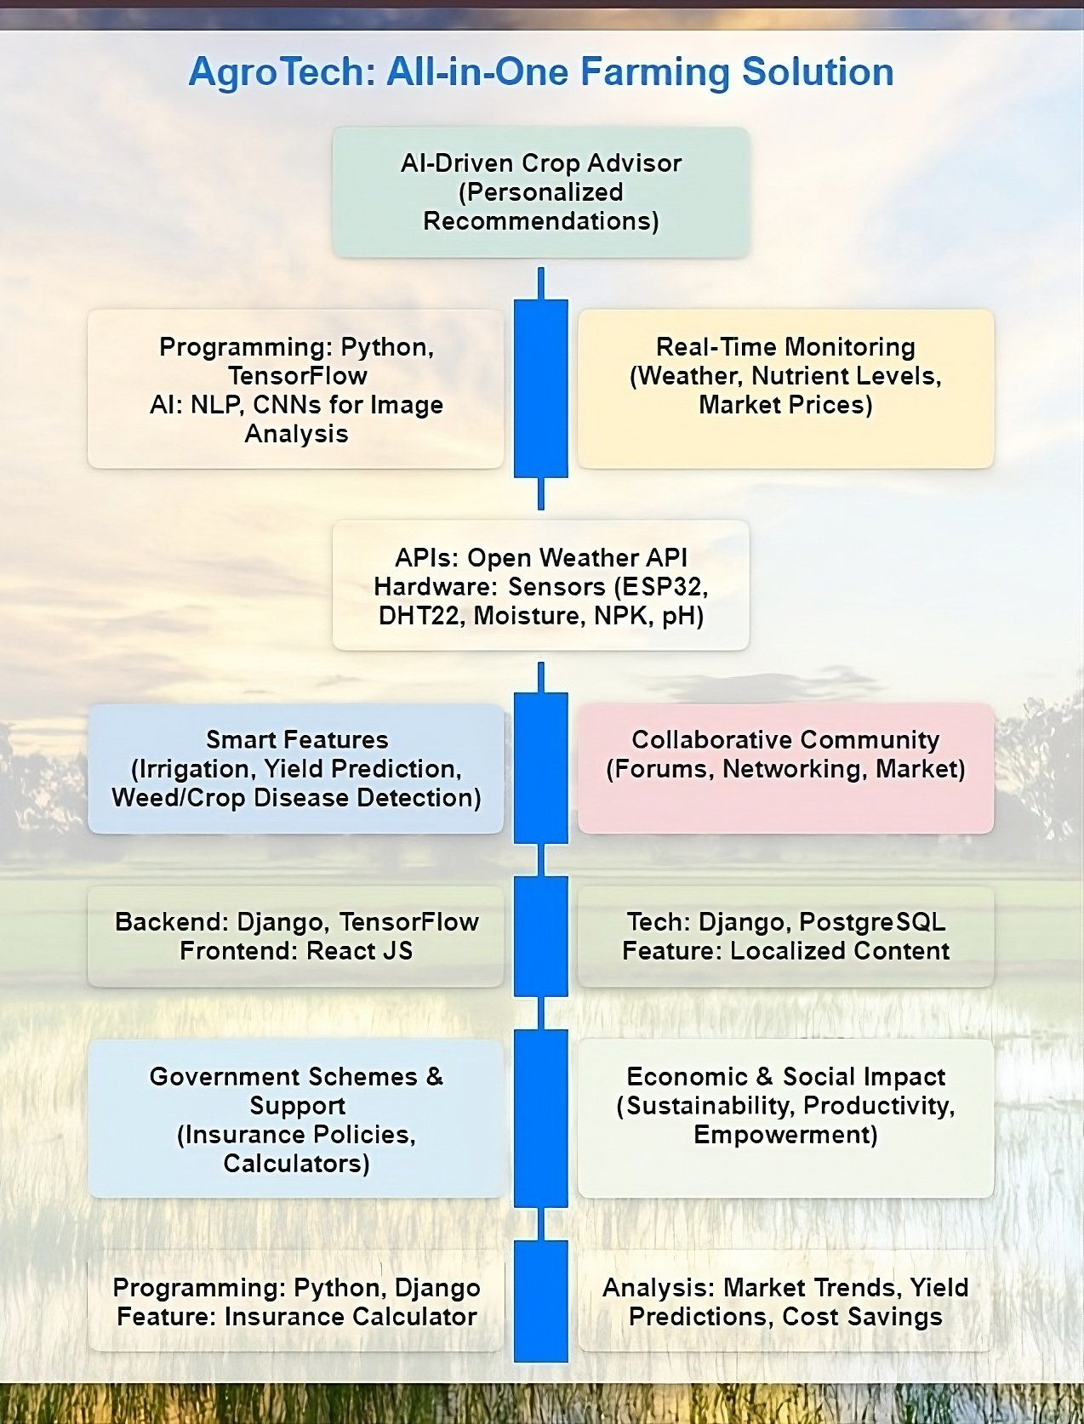
Programming Languages and Technologies:
Hardware:
○ ESP32
○ Moisture Sensor
○ DHT22 Sensor
○ NPK Sensor
○ pH Sensor
APIs:
○ Open Weather API
○ Gemini Chatbot API
○ Razorpay API
Frontend:
○ React JS
Backend:
○ Django
Database:
○ PostgreSQL
AI/ML Framework:
○ Python
○ TensorFlow
○ Convolutional Neural
Networks (CNNs)

Slide 6
Team Lead: Prannavakhanth
Email:
prannavakhanth.2023@vitstudent.ac.in
Phone: 8072212612
Member 1: K Hariprasaadh
Email:
hariprasaadh.k2023@vitstudent.ac.in
Phone: 9342856540
Member 2: Venkata krishnan G
Email:
venkatakrishnan.g2023@vitstudent.ac.in
Phone: 9940332309
Member 3: Mithil Girish
Email:
mithil.girish2023@vitstudent.ac.in
Phone: 6382320674
Member 4: Kalyan Sudarsan
Email:
kalyan.sudarsan2023@vitstudent.ac.in
Phone: 9094010117
Member 5: Lohita Lakshmi L S
Email:
lohitalakshmi.ls2023@vitstudent.ac.in
Phone: 6380431564

